Slide 1
Improve Me
Finale Project of Smart Phones
Waqar Qureshi

Slide 2

Create ML

Slide 3
Create ML Model

Slide 4
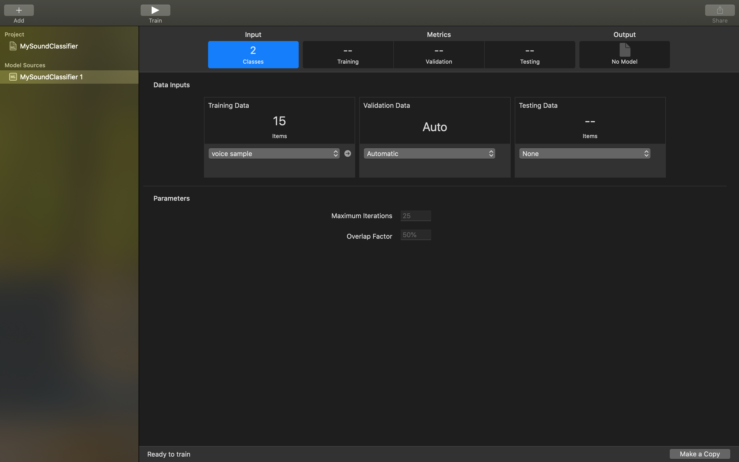

Slide 5
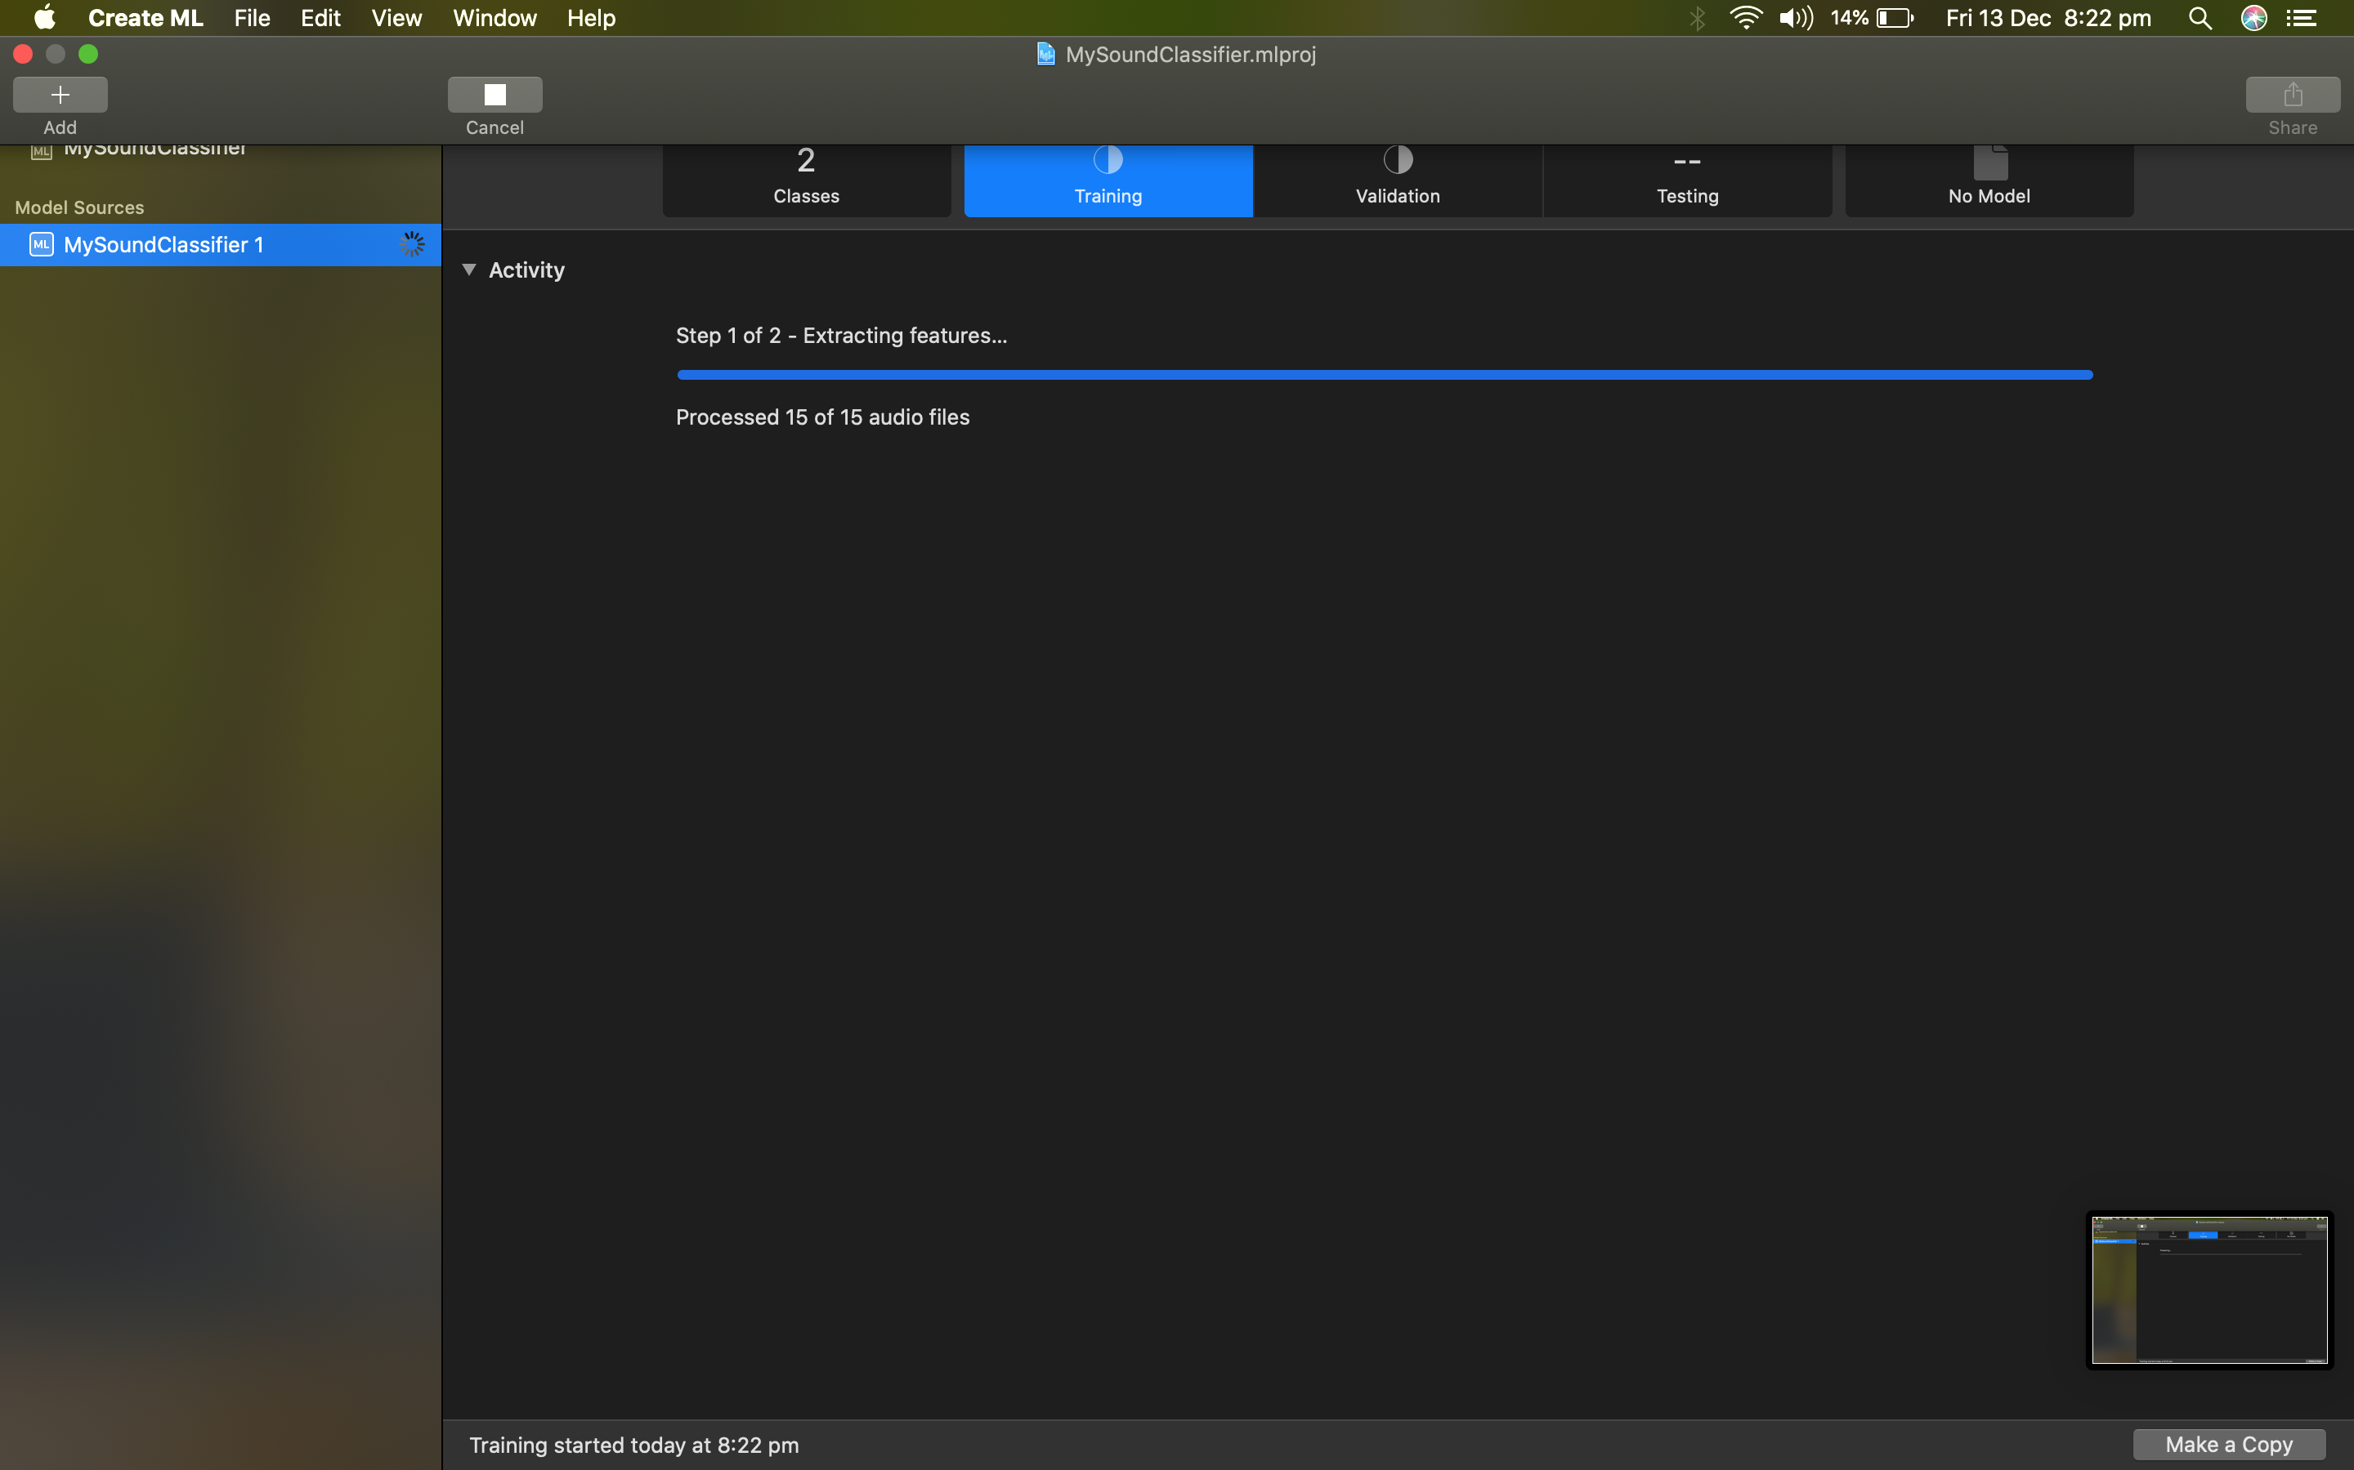

Slide 6
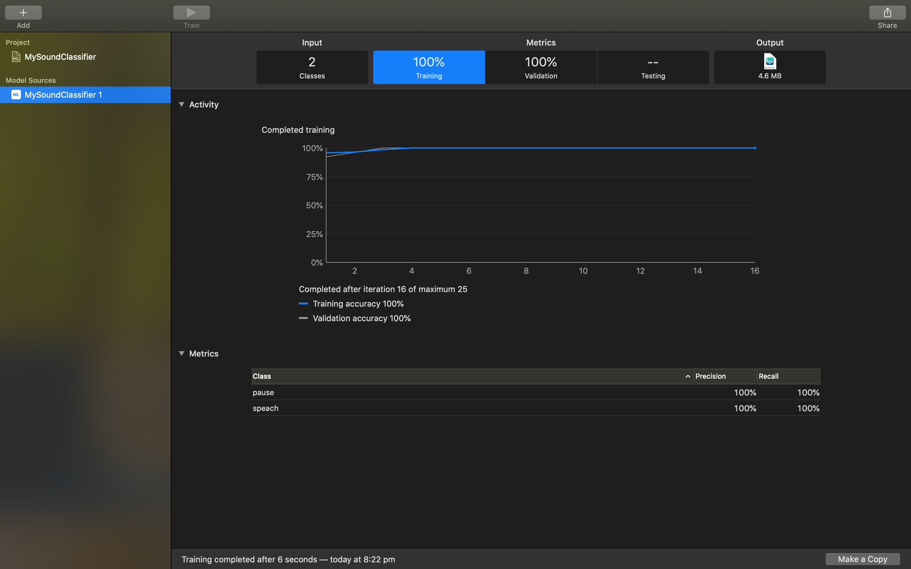

Slide 7
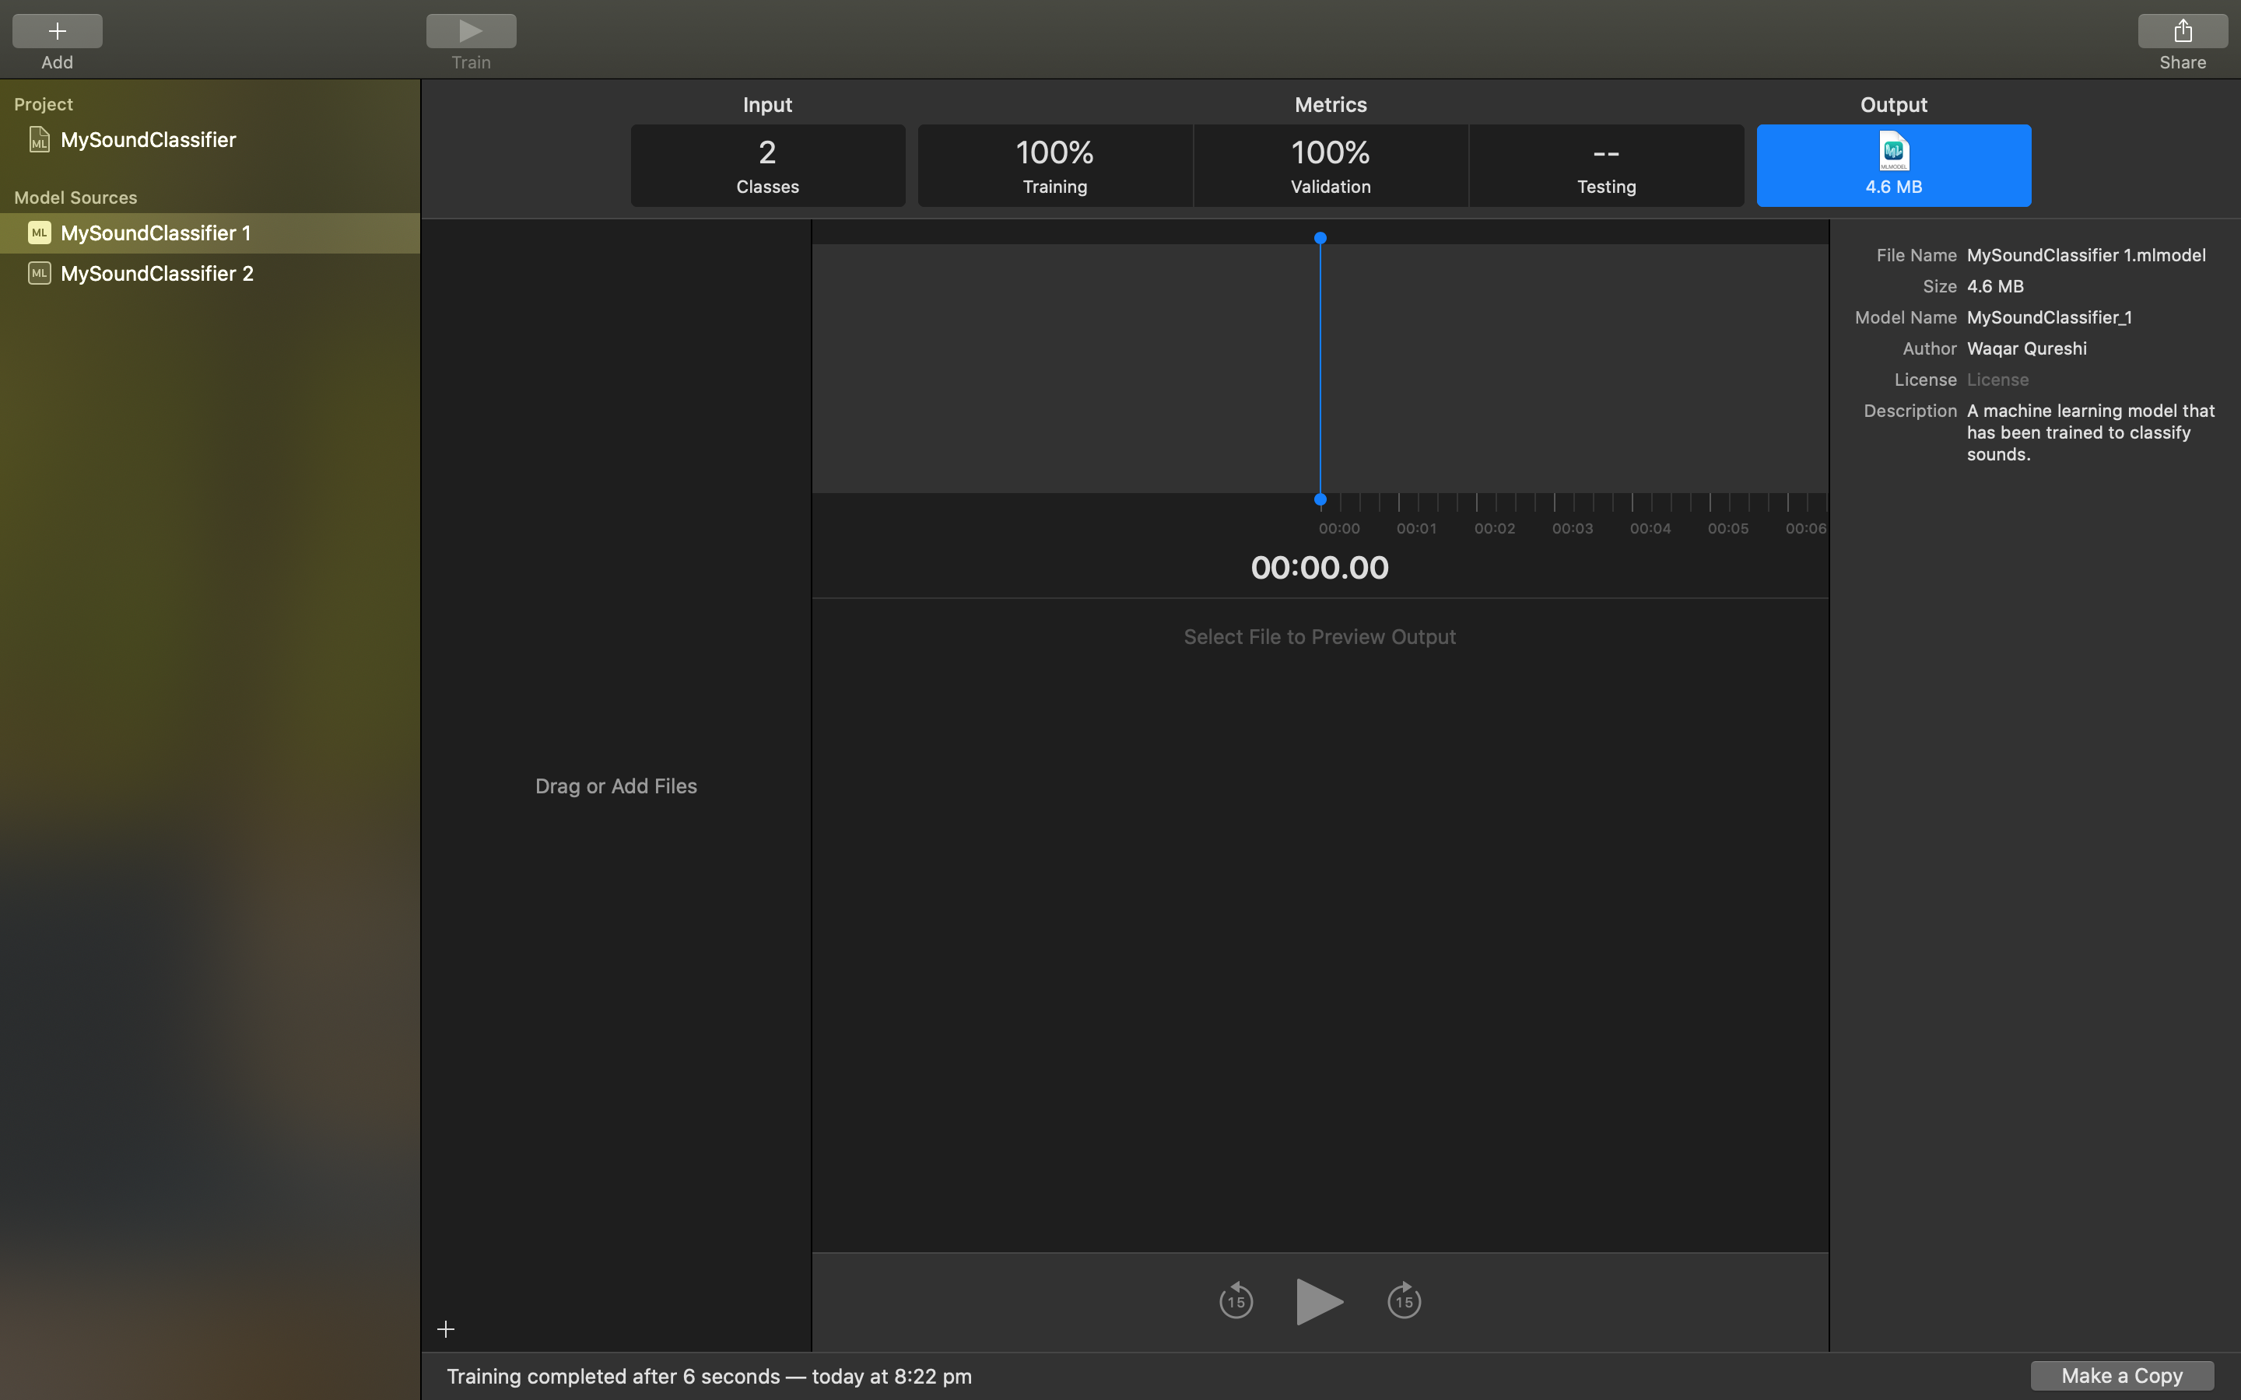

Slide 8




Slide 9
Application Demo

Slide 10
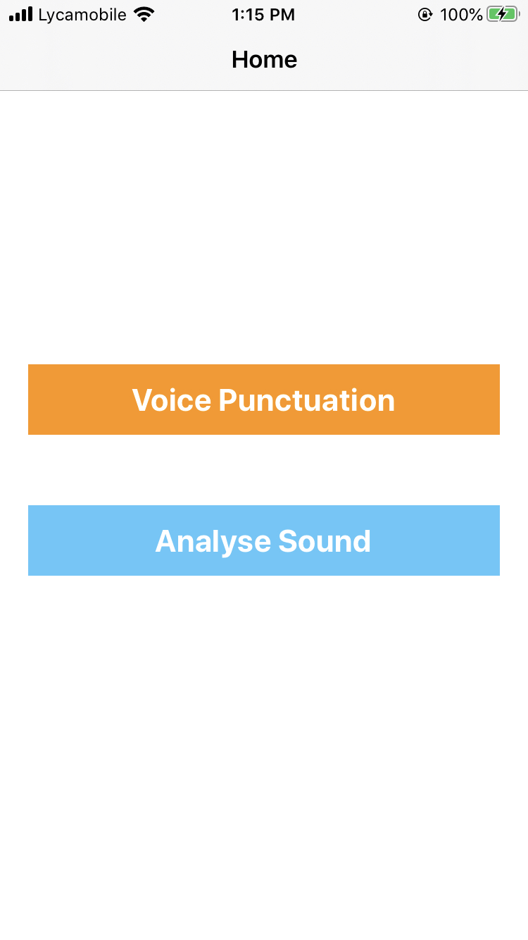
Home Screen

Slide 11

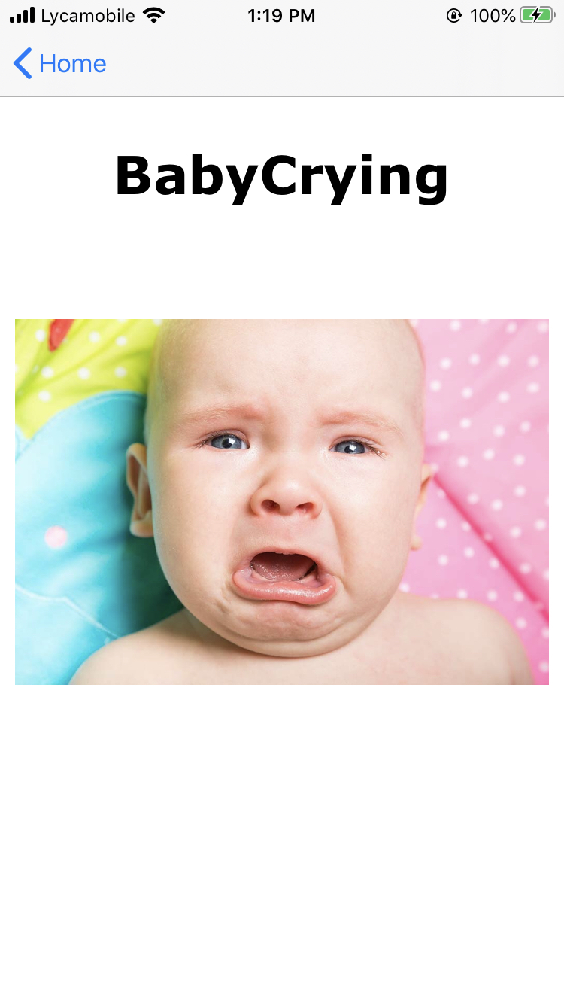
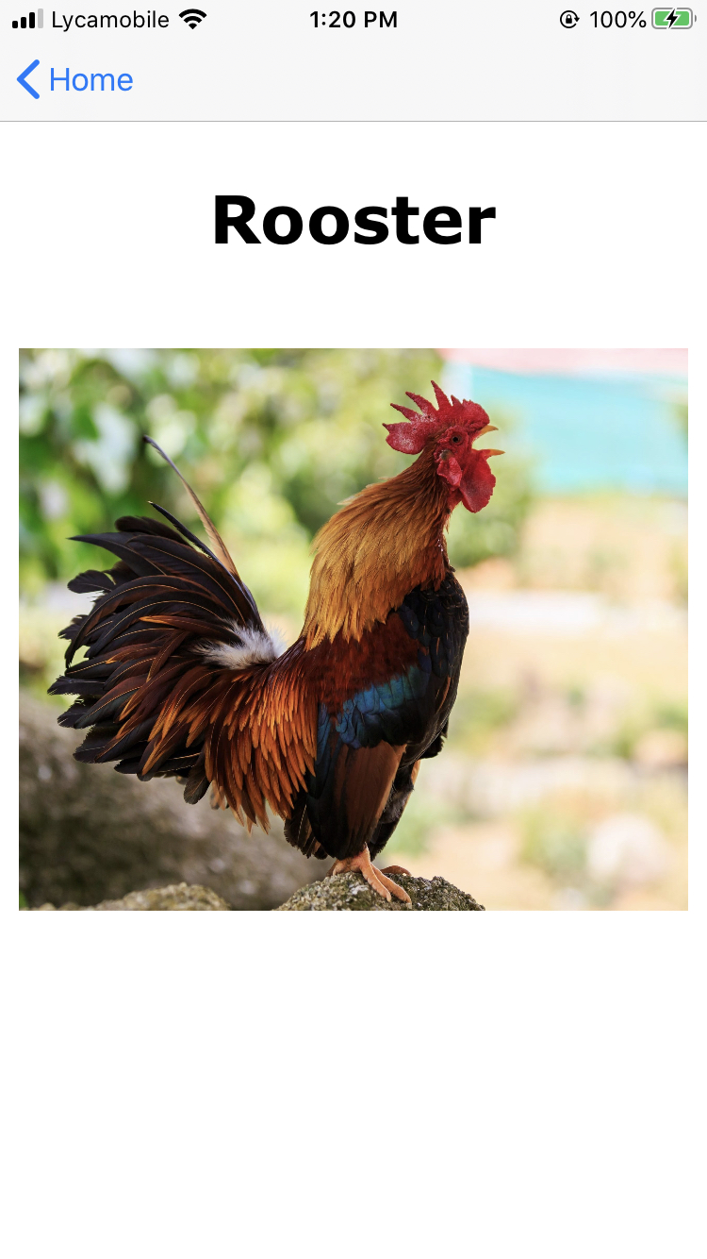
Analyze Sound Screen

Slide 12
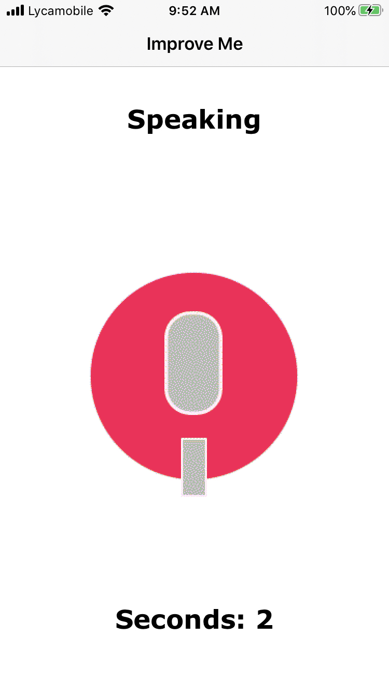
Improve Me Screen

Slide 13
Under The Hood
Sound Analysis
Label
Speak -—> Pause -—>
Confidence
0.93
0.05

Slide 14
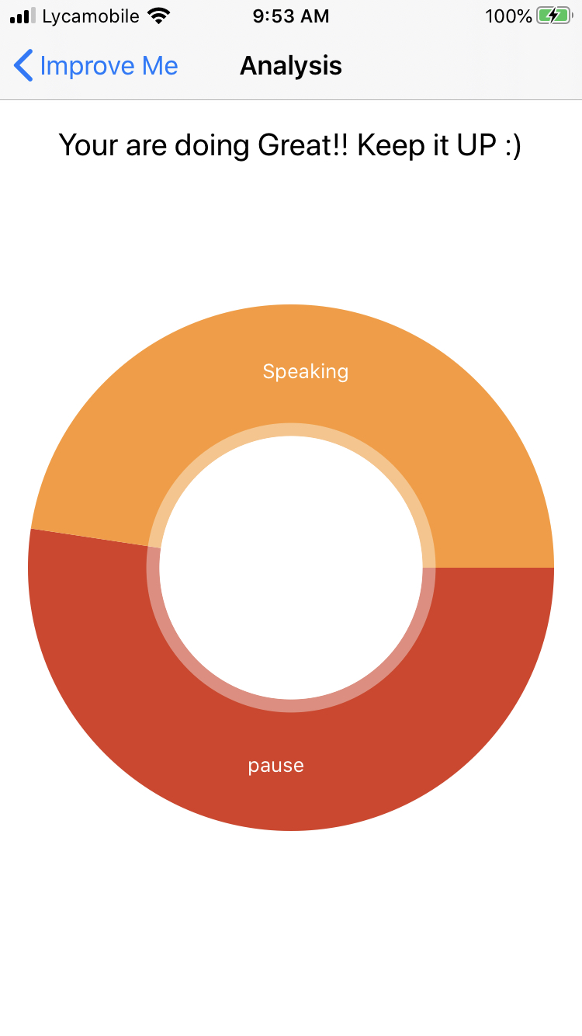
Analysis Report

Slide 15
Code
Sound Analysis Framework

Slide 16
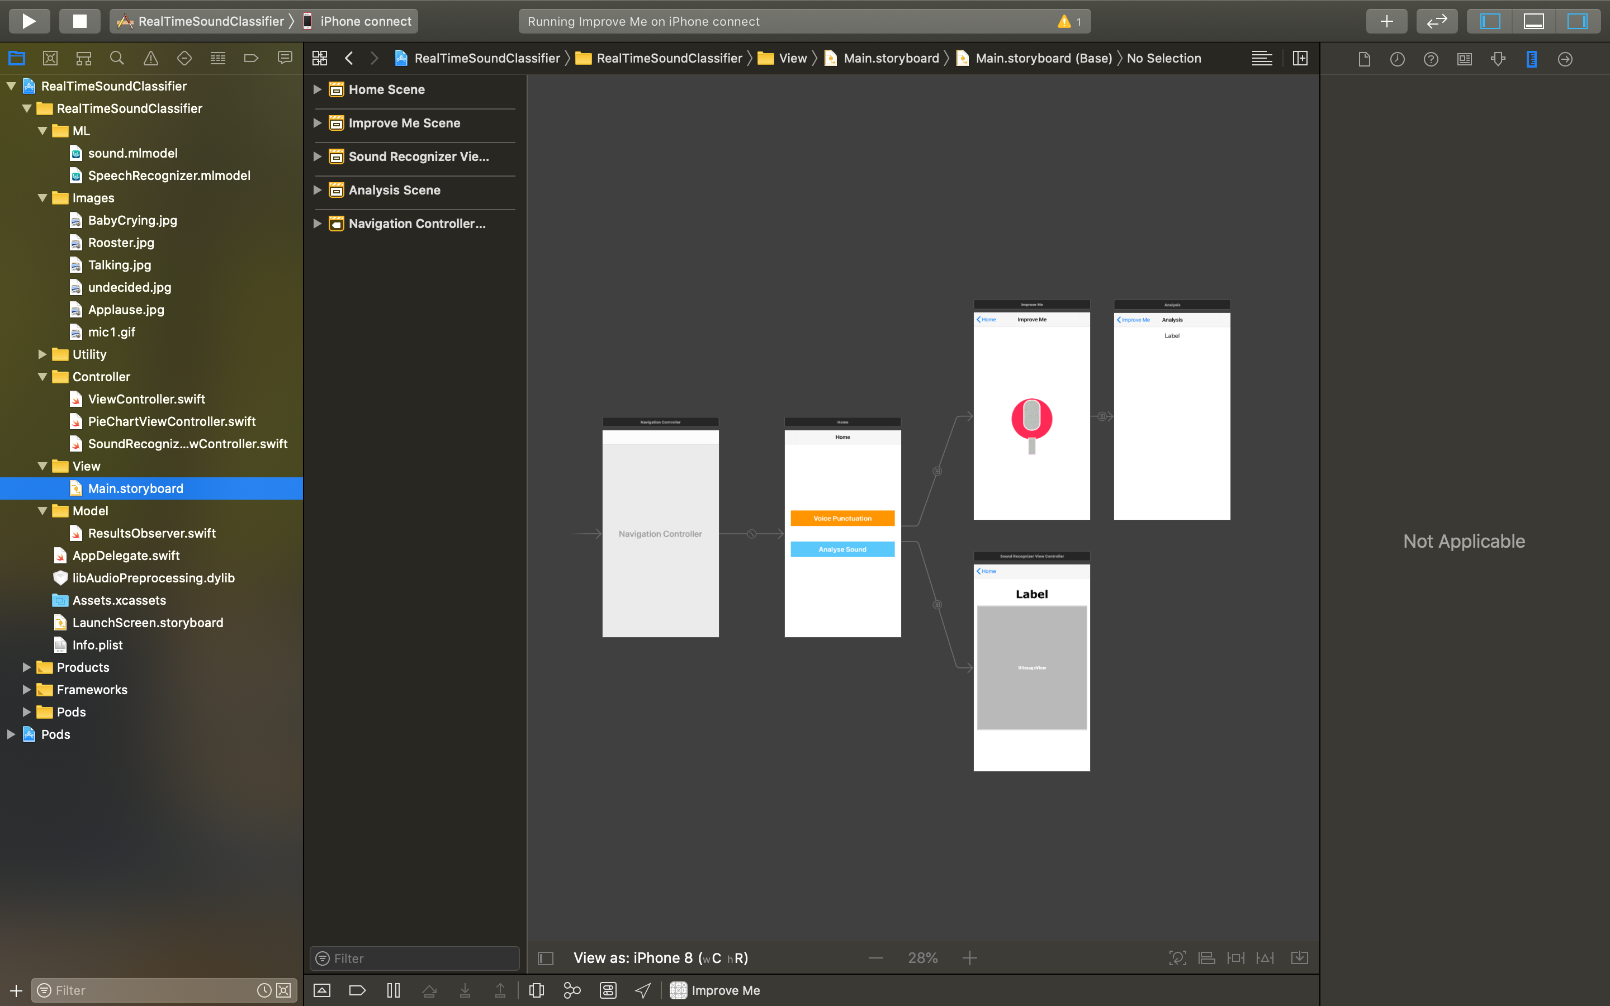
Story Board

Slide 17
// Create a file analyzer
let fileAnalyzer = try SNAudioFileAnalyzer(url: URL(fileURLWithPath: "/Users/demo/sound.caf"))
// Create the request with your MLModel
let request = try SNClassifySoundRequest(mlModel: MySoundClassifier().model)
// Add the request to the analyzer
try fileAnalyzer.add(request, withObserver: self)
// Analyze the file fileAnalyzer.analyze()

Slide 18
extension MyResultsObserver : SNResultsObserving {
func request(_ request: SNRequest, didProduce result: SNResult) {
guard let classificationResult = result as SNClassificationResult else { return } let topClassification = classificationResult.classifications.first
let timeRange = classificationResult.timeRange
// Handle result
}
func request(_ request: SNRequest, didFailWithError error: Error) {
// Handle error
}
func requestDidComplete(_ request: SNRequest) {
// Handle successful end of analysis
}
}

Slide 19
Thank You

